Slide 1

All Services Solutions
Integrated - Consultancy Services

Slide 2
Our Core Business
Our approach is based on your requirements and company goals. We define measurable objectives and engage with your teams to deliver:
Expertise and Experience
Customer Focus
Multi Skilled and Multi Cultural experienced Partnership
Sustainability.
Integration of processes and technologies to support a seamless flow of product from source to client, regardless of global complexity .
A Single Point of Contact for all your logistic needs in multi-country & multi-operation interactions

Slide 3
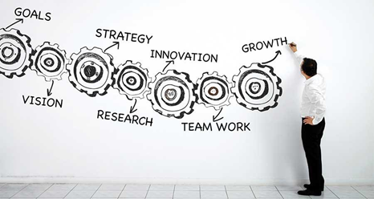
Consultancy Services
Our Management Consultancy Services Focus on the following areas:
Project Management.
Business Process management
Change Management
Data Management
Market Research
Supply Change Management
Strategic Procurement
Dashboard Development

Slide 4
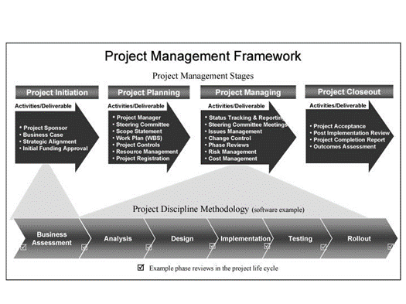
Project Management
The implementation of Project Management methodologies will be a driver to set predetermined goals, improve outcomes and strengthen the overall effectiveness of the goals and process.
It will ensure that projects of any size or complexity are managed to guarantee success and consistency throughout their life cycle.
Our clients can be confident that their project will be delivered on budget, on schedule and to their satisfaction.

Slide 5
Strategic Procurement
Our proven approach to procurement will align your unique needs with the following objectives:
Driving strategic sourcing to deliver measurable savings
Implementing the right tools and training to sustain savings and track the bottom line
Developing capabilities to drive continuous improvement through the entire supply chain
All Services Solutions will build strategic procurement strategies for your organization that will provide significant cost savings. We deploy tools, processes, and training through strategic sourcing activities such as:
Spend analysis
Supplier visibility and communication
Supplier evaluation
Performance follow
Strategic sourcing

Slide 6

Logistic Expertise
The right approach to supply Chain management because we understand that having a world class supply change management is a key factor that will set organizations apart, we have designed a portfolio of services aimed to provide the support and visibility your organization needs:
Vendors Consolidation
Freight Forwarding
Customs Brokerage Management
Strategic Sourcing
All Services Solutions provides tools to consolidate all the logistics/procurement needs of your organization under an End-to-End service; with total visibility and close follow up at every step of the way. Instead of dealing with multiple providers, invoices and currencies throughout the whole world; you will have it all under one invoice and one single point of contact

Slide 7
Data Management
Revision
Digitization
Normalization
Cataloguing,
Upload
Access to reliable information
“Unpolluted” data is core to a successful business – particularly one that relies on analytics to survive. But preparing data for analytics is full of challenges.
In fact, most data scientists spend 50 to 80 percent of their model development time simply preparing data.
The effective management of corporate data has grown in importance as businesses are subject to an increasing number of compliance regulations. Furthermore, the sheer volume of data that must be managed by organizations has increased so markedly that it is sometimes referred to as big catalogue.
Our expertise in Data Management allow us to organize your information to warranty you the use of certified reliable information, structured in easy accessible data bases.

Slide 8

Experience
The specialized consultants of All Services Solutions have a proven experience of more than 20 years in organizing, managing and implementing Logistic and Data Management processes, starting from scratch or optimizing existing processes, in following sectors:
General Management
Sourcing, Supply Chain, Procurement & Vendors selection
New Business start up
Process and policies
Courier ( DHL/ Fedex)
Bank Sector (RBC)
Oil & Gas company sector (PDVSA/Repsol)

Slide 9

Next Steps
Proven track record in transformational projects that had significant impact on efficiency , savings and optimization.
Depending on agreement working agenda to be agree on.

